Slide 1
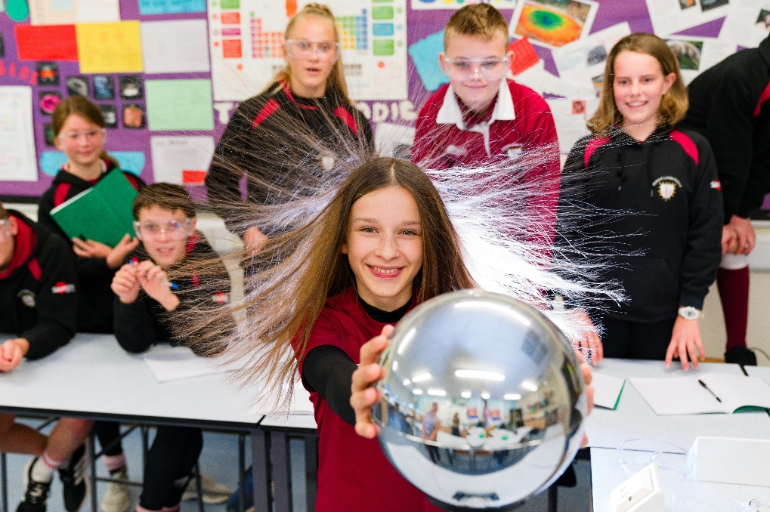
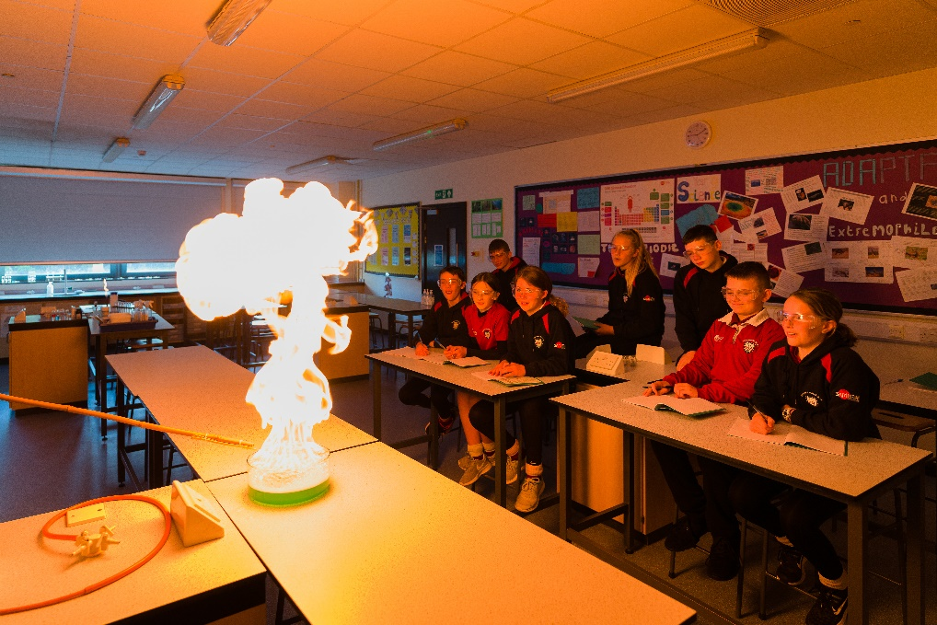

Welcome
GCSE Combined Science Revision
Notes:
Well done
A good start
Yr 11 Programme
Yr 10 responsibility – senior students

Slide 2

Exam Board: AQA
Course: GCSE Combined Science TRILOGY 8464

Slide 3
AQA TRILOGY: GCSE Combined Science Exams
12th May 2026
18th May 2026
2nd June 2026
Biology
Paper 1
70 marks
1 hour 15 min
Chemistry
Paper 1
70 marks
1 hour 15 min
Physics
Paper 1
70 marks
1 hour 15 min
8th June 2026
12th June 2026
15th June 2026
Biology
Paper 2
70 marks
1 hour 15 min
Chemistry
Paper 2
70 marks
1 hour 15 min
Physics
Paper 2
70 marks
1 hour 15 min
Notes:
Paper 1 content was taught in year 10, Paper 2 content is being taught in year 11. Some topics from both papers were taught during year 9.
Exam dates have been taken from the AQA calendar https://cdn.sanity.io/files/p28bar15/green/c5e9f9bae7272b1b48a42130fc04d77f6dd0d5b5.pdf

Slide 4
AQA TRILOGY: GCSE Combined Science
Biology Paper 1
B1 = Cell structure and transport
B2 = Cell division
B3 = Organisation and the digestive system
B4 =Organising animals and plants
B5 = Communicable diseases
B6 = Preventing and treating disease
B7 = Non-communicable diseases
B8 = Photosynthesis
B9 = Respiration
Chemistry Paper 1
C1 = Atomic structure
C2 = The periodic table
C3 = Structure and bonding
C4 = Chemical calculations
C5 = Chemical changes
C6 = Electrolysis
C7 = Energy Changes
Physics Paper 1
P1 = Conservation and dissipation of energy
P2 = Energy transfer by heating
P3 = Energy resources
P4 = Electric circuits
P5 = Electricity in the home
P6 = Molecules and matter
P7 = Radioactivity

Slide 5
AQA TRILOGY: GCSE Combined Science
Biology Paper 2
B10 = The human nervous system
B11 = Hormonal co-ordination
B12 = Reproduction
B13 = Variation and evolution
B14 = Genetics and evolution
B15 = Adaptations, interdependence and competition
B16 = Organising an ecosystem
B17 = Biodiversity and ecosystems
Chemistry Paper 2
C8 = Rates and equilibrium
C9 = Crude oil and fuels
C10 = Chemical analysis
C11 = The Earth’s atmosphere
C12 = The Earth’s resources
Physics Paper 2
P8 = Forces in balance
P9 = Motion
P10 = Forces and motion
P11 = Wave properties
P12 = Electromagnetic waves
P13 = Electromagnetism

Slide 6

GCSE Combined Science
Double Award Grading System
Students sit all 6 exams at the end of
Year 11.
The scores from all 6 papers are added up to give a mark out of 420.
This score generates the science double award grade.

Slide 7
Tiers of Entry
Higher Tier - Students can be awarded grades from 9-9 to 4-3
Foundation tier- Students can be awarded grades from 5-5 to 1-1

Slide 8
Year 11 Mock Exams
w/c Monday 3rd November Paper 1 Biology, Paper 1 Chemistry, Paper 1 Physics
w/c Monday 23rd February Paper 2 Biology, Paper 2 Chemistry, Paper 2 Physics

Slide 9
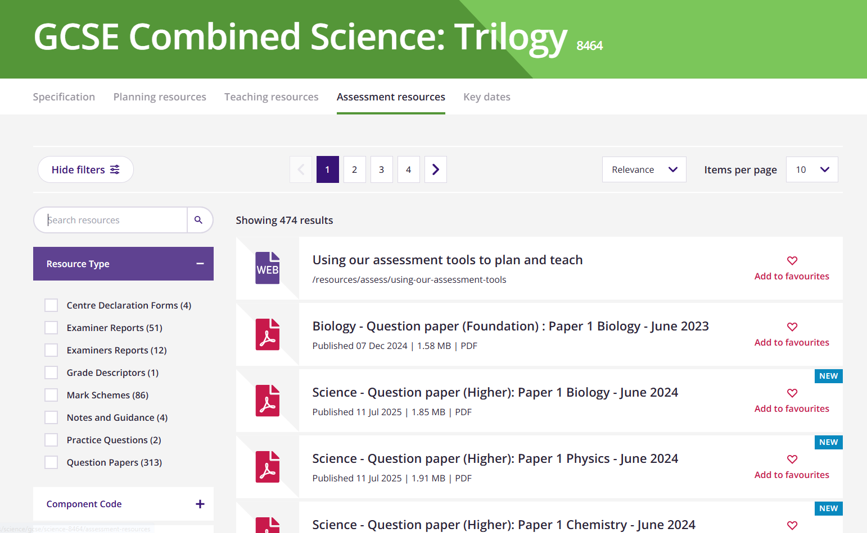
Past papers and mark schemes are available from www.aqa.org
Notes:
The AQA website has past papers and mark schemes available to download.

Slide 10
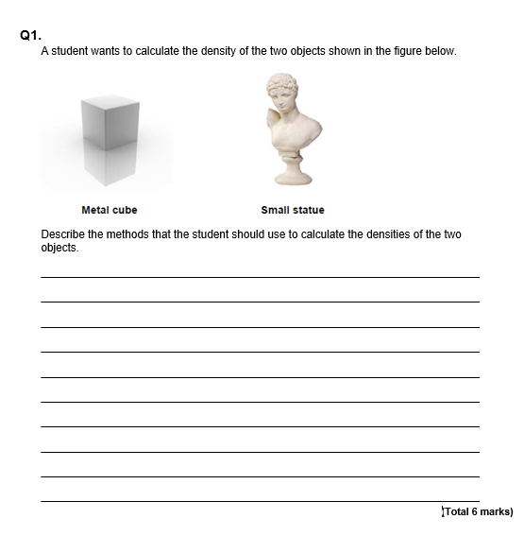
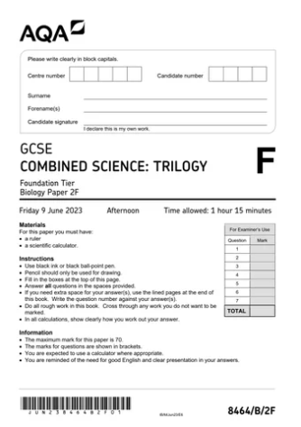
Question Style
Mixture of multiple choice, structured, closed short answer, and open response.
There are 21 Required Practicals across the 3 disciplines. Students will be examined on a selection of these practicals.
Notes:
This is an example of an open response question, the longest question type in the exams (6 marks max)

Slide 11
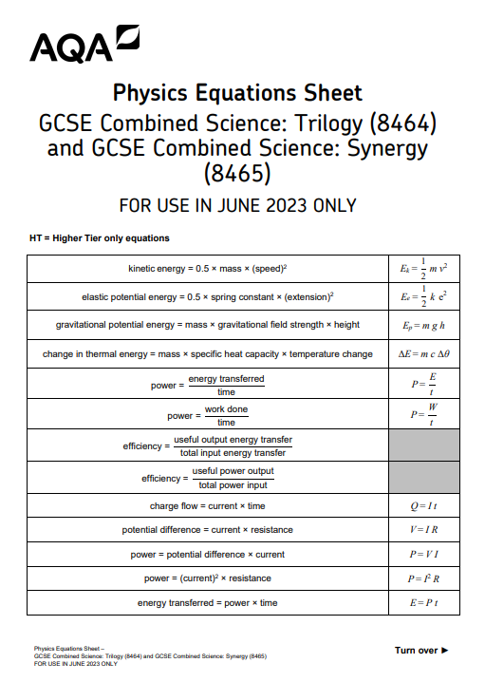
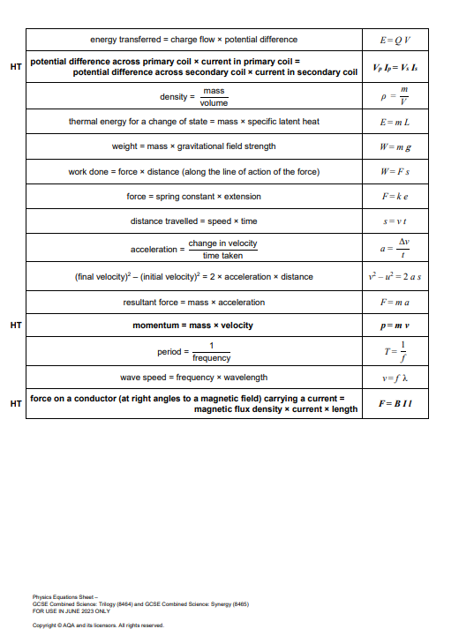
Notes:
This is a copy of the equation sheet which is given to all students for use in the exams. For both of the chemistry exams students are also given a periodic table. Calculators are permitted for use in all Science GCSE exams.

Slide 12
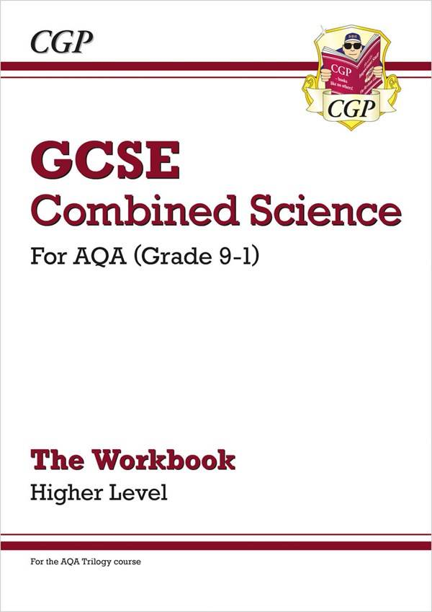


Revision guides available on ParentPay for £6.75 each
Workbooks also available on ParentPay for £7.75 each

Slide 13




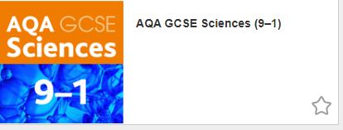
www.kerboodle.com
Online textbooks are available to view on the Kerboodle website

Slide 14
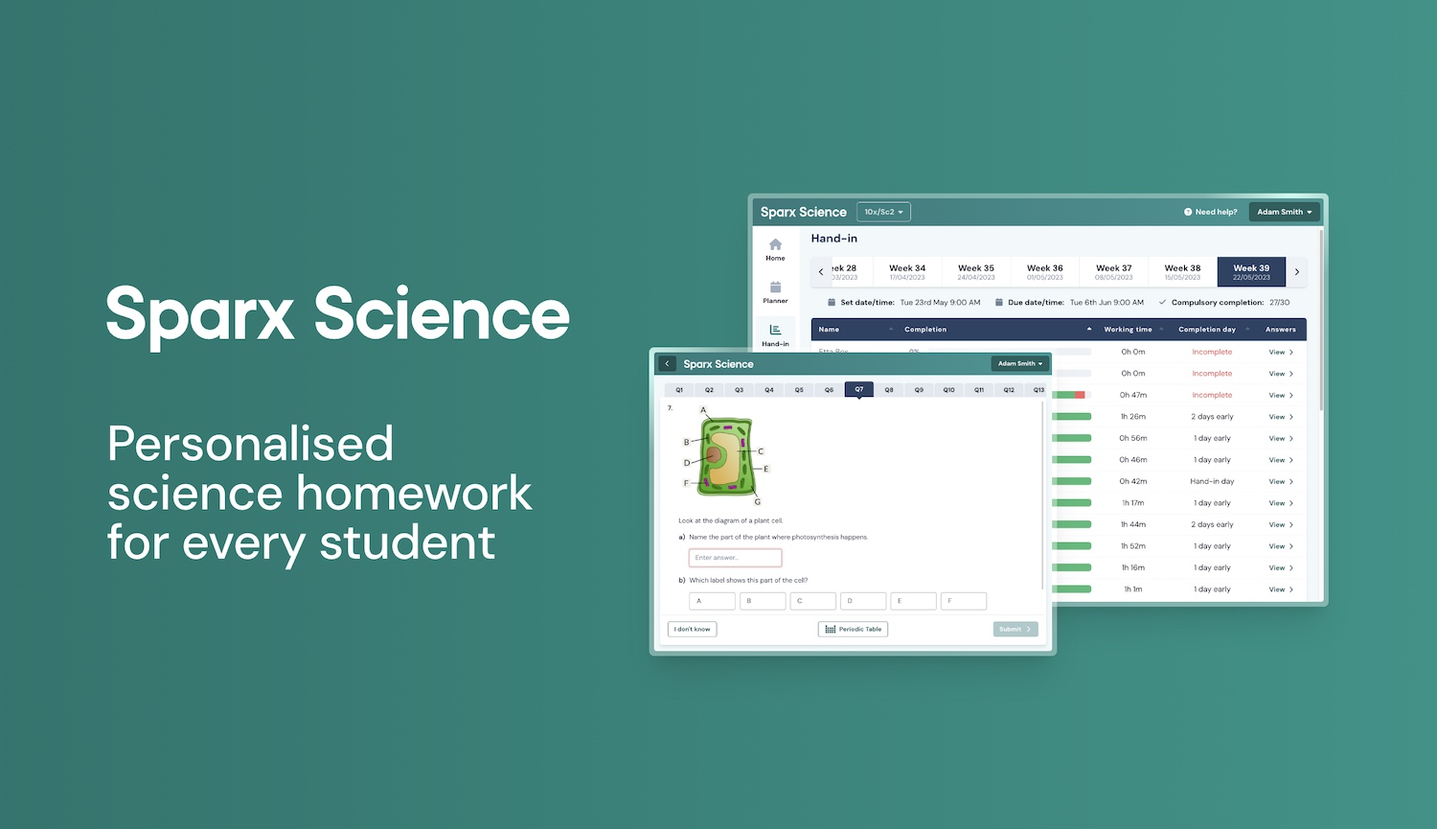

Slide 15
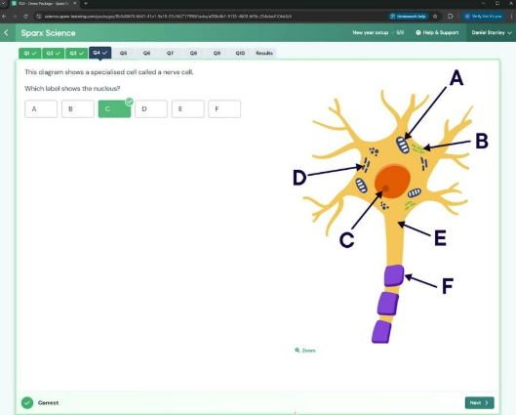
What is Sparx Science?
Sparx Science provides personalised homework that aids retention and recall.
Teachers will set topics that are coming up in the first mock series, in November.
Sometimes science questions may challenge students, however where this is the case Sparx provides unique support to fill knowledge gaps or guide them through application of scientific ideas.

Slide 16
How can you help?
Provide a quiet space for your child to focus on their homework, minimising distractions where possible.
Encourage your child to start their homework early so they can get support before the deadline if they are stuck.
Sparx Science will automatically adjust the level of questions based on your child’s answers, please try not to answer the questions for them, instead ensure they are carefully reading the support and using this information to answer the questions.

Slide 17
Key details
Students log in at app.sparx-learning.com. They will need to find their school and log in using their Sparx Maths details.
Homework will be handed out on Tuesday every week, and collected on Monday
Each Sparx Science homework should take 1 hour.

Slide 18
After School Science Revision Classes
Every Monday 3pm-4pm starting this Monday 22nd September.
Notes:
Details of rooms/topics will be posted on Moodle

