Slide 1
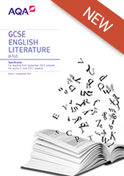

GCSE English Language and Literature
English Literature (8702)
English Language (8700)

Slide 2
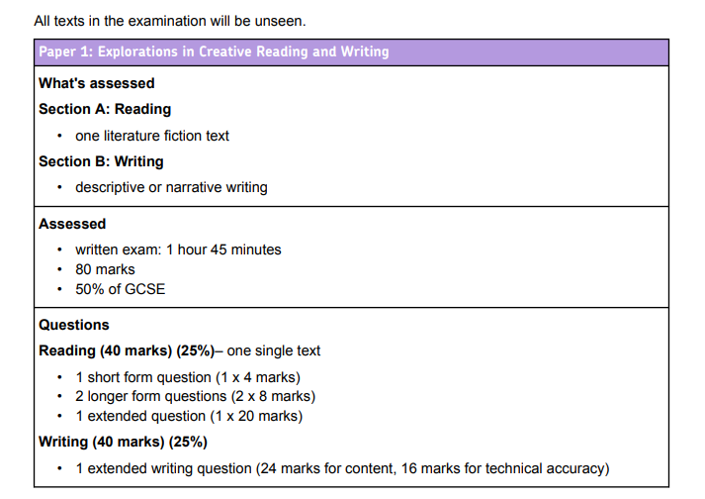
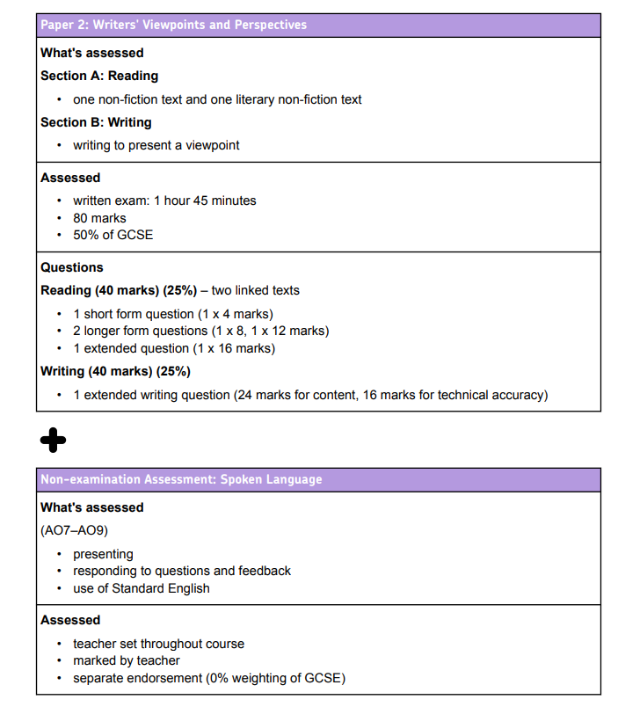
Language:

Slide 3
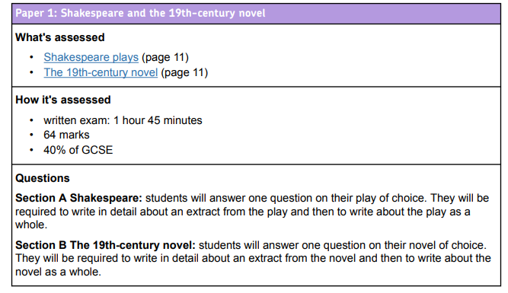
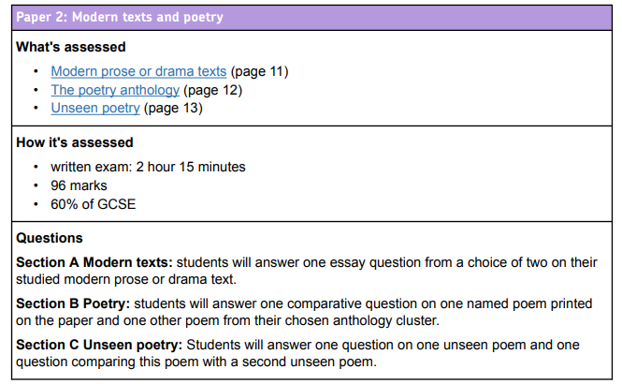
Literature:

Slide 4
Year 11 Plan: Autumn Term
English Language:
Mini-mocks
English Literature:
An Inspector Calls

Slide 5
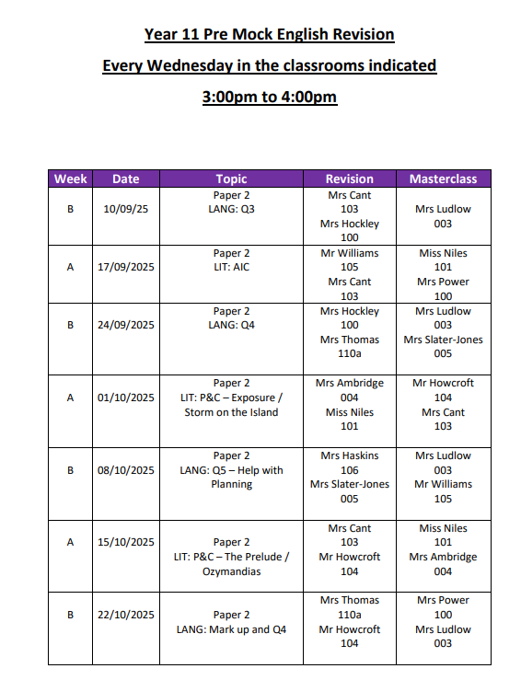

Slide 6
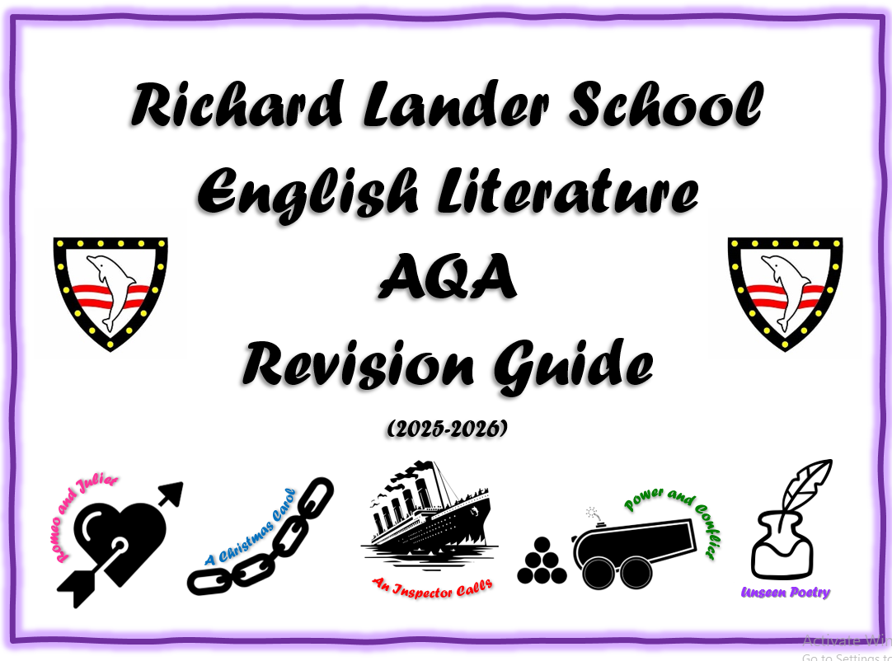
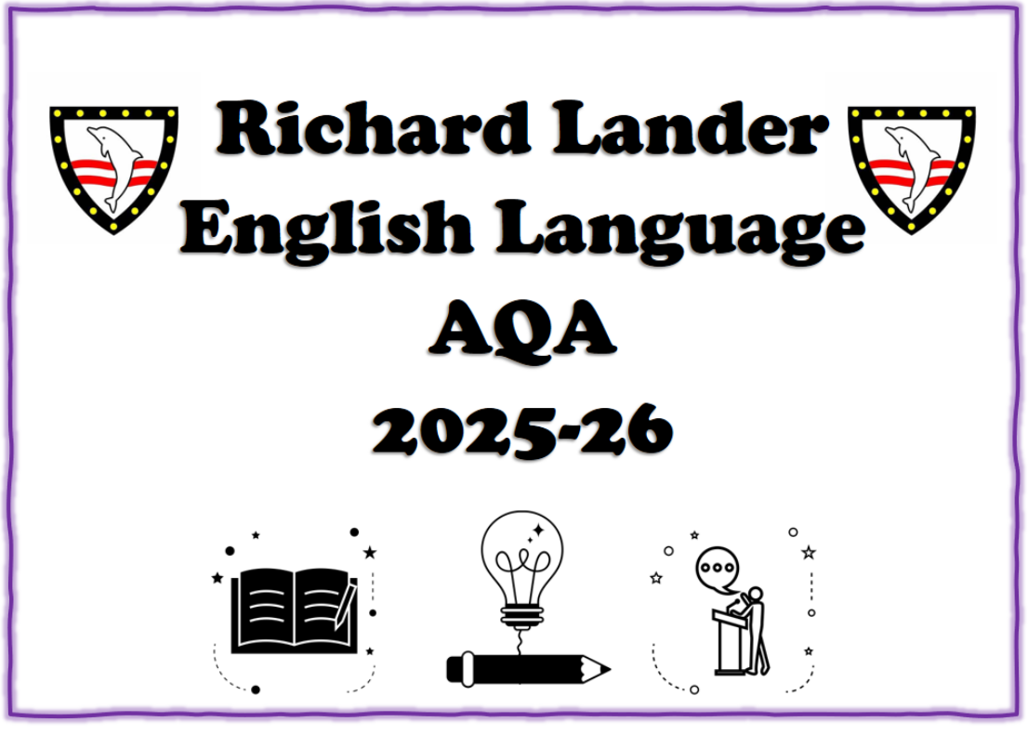
The Booklets

Slide 7

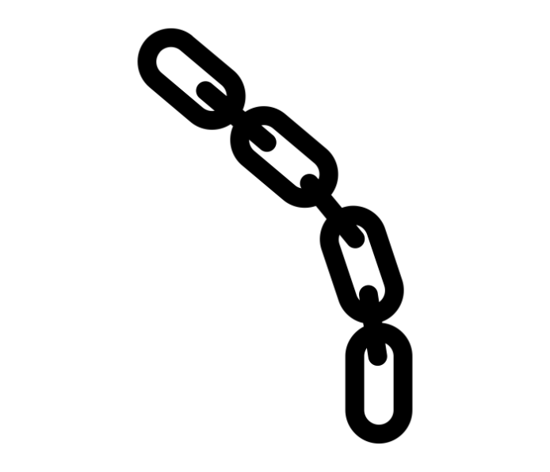
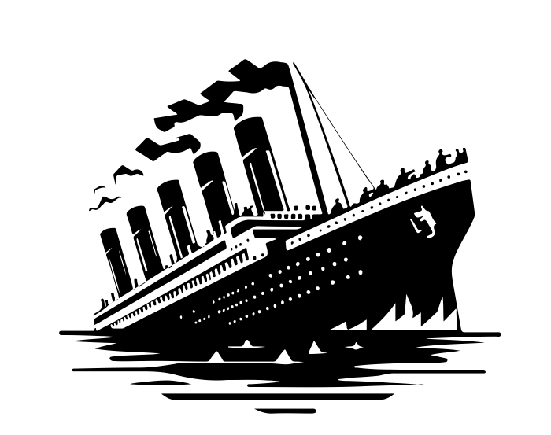



Richard Lander School English Literature AQA Revision Guide
(2025-2026)
Romeo and Juliet
A Christmas Carol
Power and Conflict
An Inspector Calls
Unseen Poetry

Slide 8


English Literature GCSE
Paper 1: Shakespeare and the 19th Century Novel
Section A: Romeo and Juliet (30 marks + 4 SPaG marks)
Section B: A Christmas Carol (30 marks)
1 hour and 45 minutes
64 marks
40% of GCSE
Extract and whole text.
Closed book exam
Paper 2: Modern Texts and Poetry
Section A: An Inspector Calls (30 marks + 4 SPaG marks)
Section B: Conflict Poetry (30 marks)
Section C: Unseen Poetry: (24 marks)
Section C: Unseen Comparison (8 marks)
2 hours 15 minutes
96 marks
60% of GCSE
Closed book exam
Romeo and Juliet
A Christmas Carol
Power and Conflict
Unseen Poetry

Slide 9
AO1: Point and Quote | 1. Explore the question focus [The author] explores [ref question] through … 2. Add Detail to Your Idea This is shown in/at [location in text] when… 3. Explain why quote is important This is demonstrated by [QUOTE] which is so important because…
A02: Exploded analysis | Firstly, the [language feature] implies… Expertly, [the author] uses the [language feature] to represent… Moreover, the use of… Furthermore, perhaps this idea could be developed by… This could make the reader consider…
A03: Context | Contextually, this is significant as [the author] is clearly trying to teach/warn/celebrate/criticise/reveal the importance of… OR This could be of historical importance as it links to…
AO1: link back to question | Therefore, [ref question] is [epitomised/typified/accentuated] at this moment because…
Verbs of Inference suggests/implies/indicates conveys/depicts/signifies illustrates/exemplifies/highlights alludes to/insinuates/intimates
Analytical Verbs accentuates/intensifies enhances/heightens creates/establishes/builds encapsulates/epitomises/typifies reinforces/strengthens symbolises/represents evokes
Reader’s Response shocks/horrifies/disgusts surprises/astonishes/amazes intrigues/entices confuses/perplexes/bewilders alienates/isolates overwhelms frustrates/angers/infuriates inspires/emboldens/empowers
Adverbs of Affirmation definitely/surely/certainly deliberately/cleverly frequently/regularly unquestionably/indubitably characteristically/typically
Modal Verbs could might may
Make an insightful point – relate back to the question in your opening line, consider writing about a clever or complex idea, that may be unusual.
Choose a relevant quotation that will support your point – but will also show a understanding of the text. For a Grade 7-9 response you would also need to embed smaller, relevant quotations in the body of your answer.
AO1
12 Marks
Analyse language/structure at word level, relating back to your point and the question.
To be exploratory in your analysis, you MUST offer an alternative viewpoint. Ensure you have developed your response.
You need to comment on what the language makes the reader think or consider.
AO2
12 Marks
Embed relevant contextual information. This could be referencing the author’s/ poet’s views and why you think he/she may have presented an idea in a certain way or it could relate to relevant historical detail.
AO3
6 Marks

Slide 10











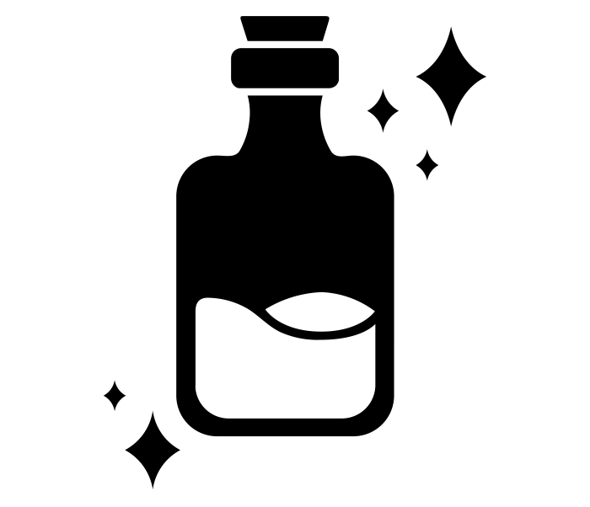



Romeo and Juliet
Paper 1
Horrified by the discovery of the dead lovers, the Montagues and Capulets end their feud.
After the Montagues and the Capulets brawl, Capulet announces he will host a ball.
Mercutio is killed by Tybalt. Romeo kills Tybalt and is banished by the Prince
Juliet takes the drug and is found apparently dead in her bed.
Lying next to Juliet’s body, Romeo takes poison and dies.
Romeo flees to Mantua, and Juliet’s wedding to Paris is arranged.
Beneath Juliet’s balcony, Romeo overhears Juliet’s declaration of love for him.
1:1
2:1
3:1
3:5
4:3
5:3
5:3
4:4
Act 1
Act 2
Act 3
Act 4
Act 5
1:5
2:6
3:5
4:1
5:3
5:3
At the ball, masked Romeo Montague is overwhelmed by Juliet’s beauty.
Returning to Verona, Romeo sneaks into Juliet’s tomb but meets Paris and kills him in a fight.
Romeo and Juliet spend their wedding night together.
Juliet wakes to find Romeo dead and stabs herself in despair.
Juliet is persuaded by Friar Lawrence to drug herself to escape her wedding to Paris.
Romeo and Juliet are secretly married by Friar Lawrence.

Slide 11







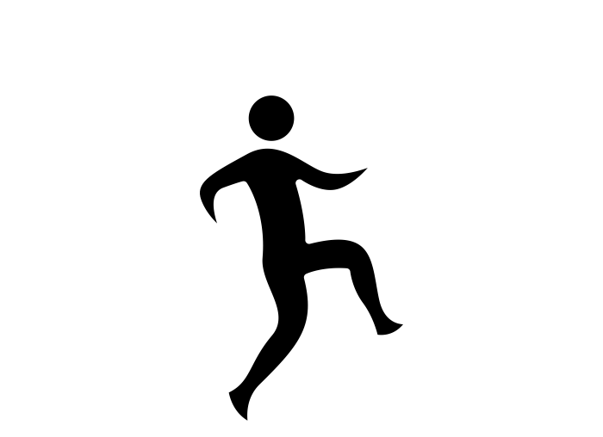






















Romeo and Juliet
Romeo | Love is a smoke made with the fumes of sighs.’ Romeo (A1S1) p.25 | ‘It is the east, and Juliet is the sun. / Arise, fair sun, and kill the envious moon.’ Romeo (A2S2) P.71 | ‘And fire-eyed fury be my conduct now!’ ‘O, I am fortune’s fool.’ Romeo (A3S1)
Juliet | ‘My bounty is as boundless as the sea, my love as deep.’ (Juliet A2S2) P.79 | ‘You have comforted me marvellous much.’ ‘Ancient damnation, O most wicked fiend.’ Juliet (A3S5) P.169 | ‘O bid me leap into a new-made grave…without fear or doubt to live an unstained wife to my sweet love.’ Juliet (A4S1) P.175
Conflict | “..talk of peace! I hate the word, As I hate hell, all Montagues, and thee.” (Tybalt A1S1) p.17 ‘My only love sprung from my only hate.’ Juliet (A1S5) P.63 | ‘O Calm, dishonourable, vile submission’ ‘A plague on both your houses.’ Mercutio (A3S1) P.121 | ‘O happy dagger!’ Juliet (A5S3) P.223
Age Vs Youth | ‘My child is yet a stranger in the world.’ Lord Capulet (A1S2) p.29 | ‘Hang thee young baggage disobedient wretch.’ Capulet (A3S5) p.165 | ‘Death lies on her like an untimely frost / Upon the sweetest flower of all the field.’ (Lord Capulet) p.193
Fate | ‘A pair of star-crossed lovers take their life.’ The Prologue p.11 | ‘These violent delights have violent ends, And in their triumph die like fire and powder which as they kiss consume.’ The Friar (A2S6) p.111 | ‘shake the yoke of inauspicious stars from this world-wearied flesh.’ Romeo (A5S3) P.217

Slide 12
AO3 Context: Romeo and Juliet
Romeo | Exposes the tension between Romeo’s emotional vulnerability and societal expectations of male strength, showing how sensitivity was often seen as weakness. Explores the destructive pressure on young men to defend honour with violence, as Romeo feels compelled to kill Tybalt to prove his masculinity. Contrasts Romeo’s poetic, idealistic love with Mercutio’s crude, mocking attitude, revealing a spectrum of masculine behaviour in Shakespeare’s world. Suggests that toxic masculinity contributes to tragedy, as Romeo’s desire to be seen as honourable leads him to make rash, irreversible decisions. Questions the idea that masculinity must be expressed through aggression, portraying Romeo as both a lover and a fighter, caught between opposing identities.
Juliet | Reinforces the idea that women were expected to be obedient daughters, as Juliet initially submits to her parents’ will, showing the restrictive expectations placed on girls. Challenges traditional gender roles by allowing Juliet to defy her father and choose love over duty, suggesting Shakespeare’s sympathy for individual agency within a patriarchal system. Highlights how Juliet’s sexual and emotional independence (especially in the balcony and wedding scenes) subverts the Elizabethan ideal of silent, passive femininity. Reflects the limited autonomy of women, as Juliet is ultimately trapped by decisions made by the men around her — father, husband, Friar — underlining the dangers of a male-dominated society. Criticises a culture in which women are commodified in marriage negotiations, as seen in Capulet's treatment of Juliet as his property to trade for social advantage.
Conflict | Illustrates how honour culture demands violence to defend reputation, as seen in Tybalt’s obsession with duelling and Romeo’s eventual participation. Demonstrates that pride often overrides reason, particularly when Romeo kills Tybalt, transforming personal grief into social revenge. Critiques the generational perpetuation of conflict, with older men like Capulet and Montague failing to end a feud that consumes their children. Reveals that the pursuit of honour and revenge leads to a cycle of escalation, turning personal grievances into collective tragedy. Warns against allowing pride to dictate action, as Shakespeare shows how male ego and status lead directly to loss and death.
Age Vs Youth | Depicts the older generation as out of touch, with Capulet and the Nurse misunderstanding or dismissing the emotional depth of young love. Emphasises the impulsiveness and intensity of youth, contrasting it with the caution or stubbornness of adults like Friar Lawrence and Capulet. Reinforces patriarchal dominance through Capulet’s fury when Juliet disobeys him, showing how daughters were expected to be submissive and silent. Undermines the wisdom of the old, as their advice and decisions (e.g., Friar’s plan, the Nurse’s betrayal) contribute to the lovers' downfall. Highlights the rigid structure of social hierarchy and family authority, suggesting that young people are often powerless against systems designed to control them.
Fate | Foreshadows inevitable tragedy with the Prologue’s “star-cross’d lovers”, suggesting from the outset that fate governs the characters’ lives. Blames Romeo’s hamartia — his impulsiveness — for accelerating the tragic events, aligning him with the classical model of a flawed tragic hero. Blurs the boundary between fate and free will, as characters frequently make poor choices that seem driven by both destiny and emotion. Strengthens the theme of fatal miscommunication, portraying fate as an invisible force working through coincidence and timing. Reflects Elizabethan beliefs in astrology and divine will, using fate not just as a plot device but as a commentary on human helplessness in the face of destiny.

Slide 13
AQA Literature Paper 1: Past Paper Questions
SECTION A: Romeo and Juliet
30 marks
Text | Exam | Extract | Question
 | June 2025 | Act 3, Scene 5 | Starting with this moment in the play, explore how Shakespeare presents relationships between parents and children
Romeo and Juliet | June 2024 | Act 2 Scene 5 | Starting with this speech, explore how Shakespeare presents the difficulties faced by Juliet in Romeo and Juliet.
 | June 2023 | Act 3 Scene 2 | Starting with this speech, explore how Shakespeare presents Juliet’s feelings towards Romeo.
 | June 2022 | Act 2 Scene 2 | Starting with this speech, explore how Shakespeare presents Romeo’s feelings towards Juliet.
 | Nov 2021 | Act 3 Scene 2 | Starting with this conversation, explore how far Shakespeare presents Juliet as a female character with strong emotions.
 | June 2021 | Act 3 Scene 2 | Starting with this conversation, explore how far Shakespeare presents Juliet as a female character with strong emotions.
 | Nov 2020 | Act 1 Scene 1 | Starting with this speech, explore how Shakespeare presents the effects of the conflict between the Capulet and Montague families. (Prince speech)
 | June 2020 | Act 1 Scene 1 | Starting with this speech, explore how Shakespeare presents the effects of the conflict between the Capulet and Montague families. (Prince speech)
 | June 2019 | Act 1 Scene 5 | Starting with this conversation, explore how Shakespeare presents the relationship between Romeo and Juliet.
 | June 2018 | Act 3 Scene 5 | Starting with this moment in the play, explore how Shakespeare presents relationships between adults and young people in Romeo and Juliet.
 | June 2017 | Act 1 Scene 1 | Starting with this conversation, explore how Shakespeare presents aggressive male behaviour in Romeo and Juliet.
 | SAMS3 | Act 2 Scene 2 | Starting with this moment in the play, how does Shakespeare present Romeo’s attitudes to love?
 | SAMS2 | Act 3 Scene 2 | Starting with this speech, explore how Shakespeare presents attitudes towards love in Romeo and Juliet.
 | SAMS1 | Act 1 Scene 2 | Starting with this conversation, explain how far you think Shakespeare presents Lord Capulet as a good father.

Slide 14
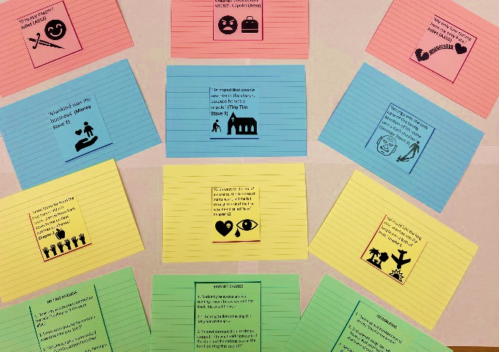
Intro to Literature Revision: For every flashcard complete the following:
AO1:
What characters or themes does your quotation link to? Why is it a significant quotation? Write these ideas across the top of your flashcard.
AO2:
Explode the language/structure within the quote x3 (implies/suggests/denotes)
AO3:
Contextually, the [author/poet] is clearly trying to criticise/ to warn/ to reveal the importance of/ to celebrate/ to teach…
OR
Historically, these ideas are significant as they are linked with…

Slide 15
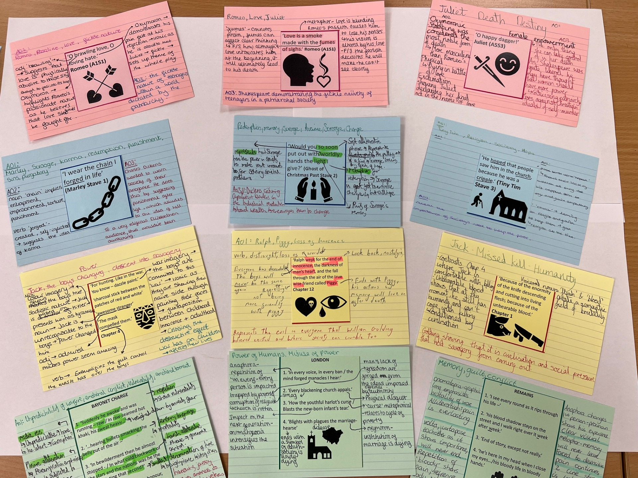
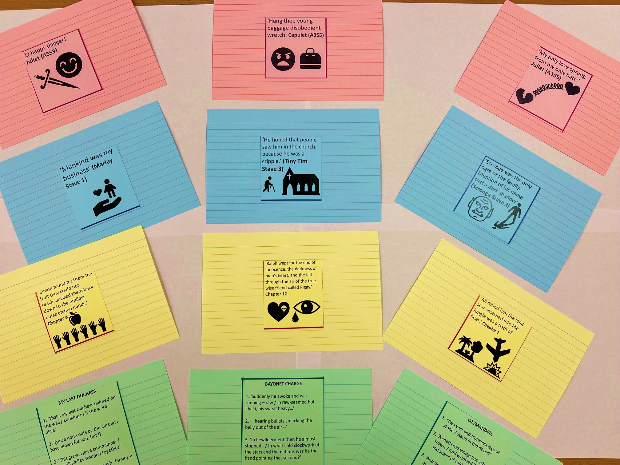

Slide 16

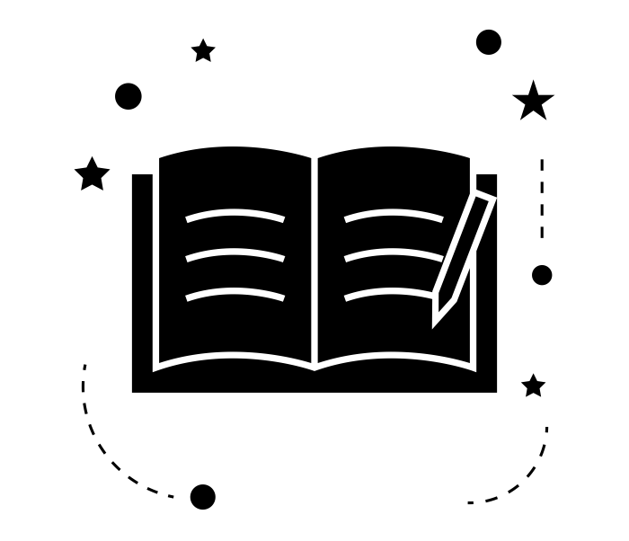

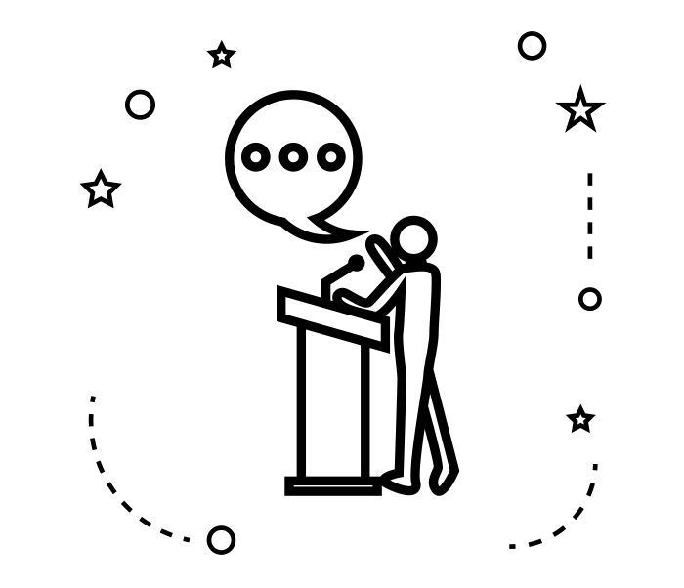
Richard Lander English Language AQA 2025-26

Slide 17
Suggested Question Order
English Language GCSE
Paper 1: Explorations in Creative Reading and Writing
1 hour 45 minutes
80 marks
50% of GCSE
Paper 2: Writers’ Viewpoints and Perspectives
1 hour 45 minutes
80 marks
50% of GCSE
Your teacher may suggest you answer the questions in this order to maximise your potential in the exam
Paper 1
Q5, Q1, Q2, Q4, Q3
Paper 2
Q5, Q1, Q3, Q4, Q2
Non-examination Assessment: Spoken Language Study

Slide 18



ENGLISH LANGUAGE Paper 1 Sentence Stems and Top Tips

Slide 19

Paper 1 – Overview Explorations in creative reading and writing 1 hr 45 minutes
Reading: you are given an extract from a 19th / 20^{th/} or 21st century story
Read an extract from a story
Q1 - read a specific section and respond to multiple choice questions [4 marks] 3 minutes
Q2 – read a specific section and answer a question on language [8 marks] 10 minutes
Q3 – read the whole text and answer a question about structure [8 marks] 10 minutes
Q4 – read a specific section and state analytically whether you agree with a statement on the text using quotations and analysing language [20 marks] 25 minutes
Writing: Given an image and an alternative creative writing question
Q5 - Focus on language devices, sentence starters, paragraphing, punctuation, vocabulary [40 marks] 45 minutes
10 minutes reading through sources and checking – read through sources first before beginning Q5

Slide 20


Q2: Mark Scheme
Question 2: Language Analysis
8 marks
10 minutes
2 x dev paragraphs
Level | Skills Descriptors
Level 4: Detailed, perceptive analysis 7-8 marks | Shows detailed and Perceptive understanding of language: • Analyses the effects of the writer’s choices of language • Selects a judicious range of textual detail • Makes sophisticated and accurate use of subject terminology
Level 3: Clear, relevant explanation 5-6 marks | Shows clear understanding of language: • Explains clearly the effects of the writer’s choices of language • Selects a range of relevant textual detail • Makes clear and accurate use of subject terminology
Level 2: Some understanding and comment 3-4 marks | Shows some understanding of language: • Attempts to comment on the effect of language • Selects some appropriate textual detail • Makes some use of subject terminology, mainly appropriately
Level 1: Simple, limited comment 1-2 marks | Shows simple awareness of language: • Offers simple comment on effect of language • Selects simple references or textual detail • Makes simple use of subject terminology, not always appropriately
The writer explores the idea of [ref question] when…
This is shown in ‘QUOTE’
Firstly, the [language feature] implies…
Furthermore, the writer uses the [language feature] to present…
Moreover, the use of [language feature] makes the reader consider/feel…
Therefore, it is clear [ref question] is presented as…
Language Features:
Word
Phrase
Imagery
Abstract noun
Verb
Adverb
Adjective
Metaphor
Simile
Sensory language
Personification
Oxymoron
Alliteration
Juxtaposition
Plosive/fricative/sibilance
Semantic field

Slide 21

Q3: Mark Scheme
Question 3: Structure 8 marks 10 minutes
2 x dev paragraphs
Choose your two best moments from the text to write about.
Level | Skills Descriptors
Level 4 Detailed, perceptive analysis 7-8 marks | Shows detailed and perceptive understanding of structural features: • Analyses the effects of the writer’s choice of structural features • Selects a judicious range of examples • Makes sophisticated and accurate use of subject terminology
Level 3 Clear, relevant explanation 5-6 marks | Shows clear understanding of structural features: • Explains clearly the effects of the writer’s choice of structural features • Selects a range of relevant examples • Makes clear and accurate use of subject terminology
Level 2 Some understanding and comment 3-4 marks | Shows some understanding of structure: • Attempts to comment on the effect of structural features • Selects some appropriate textual detail • Makes some use of subject terminology, mainly appropriately
Level 1 Simple, limited comment 1-2 marks | Shows simple awareness of language: • Offers simple comment on effect of structure • Selects simple references or textual detail • Makes simple use of subject terminology, not always appropriately
At the beginning of the text the writer creates a feeling of [ref question] when…
This is shown by ‘QUOTE’
The use of the [structural feature] could suggest…
The writer then shifts the focus to…which heightens the feeling of [ref question]…
This is shown by ‘QUOTE’
The use of [structural feature] creates a feeling [ref question] because...
The writer creates a really interesting feeling of [ref question] at the end of the text when…
This is shown by ‘QUOTE’
Therefore, the use of [structural feature] makes the reader feel…
Beginning
Shift
Ending
Beginning
Structural features:
Hook
Motif
Zooming in
Foreshadowing
Shift in focus
Shift in perspective
Flashback
Contrast
Repetition
Motif
Cyclical structure
Cliffhanger
Shift
Possible Question Foci:
Tension
Anxiety
Unease
Suspense
Intrigue
Confusion
Ending

Slide 22

Q4: Mark Scheme
Question 4: Evaluate 20 marks 25 minutes
3 x dev paragraphs
p
Q
M
E
S
Level | Skills Descriptors
Level 4 Perceptive, detailed evaluation 16-20 marks | Shows perceptive and detailed evaluation: Evaluates critically and in detail the effect(s) on the reader Shows perceptive understanding of writer’s methods Selects a judicious range of textual detail Develops a convincing and critical response to the focus of the statement
Level 3 Clear, relevant evaluation 11-15 marks | Shows clear and relevant evaluation: Evaluates clearly the effect(s) on the reader Shows clear understanding of writer’s methods Selects a range of relevant textual references Makes a clear and relevant response to the focus of the statement
Level 2 Some evaluation 6-10 marks | Shows some attempts at evaluation: Makes some evaluative comment(s) on effect(s) on the reader Shows some understanding of writer’s methods Selects some appropriate textual reference(s) Makes some response to the focus of the statement
Limited Simple, limited evaluation 1-5 marks | Shows some, simple limited evaluation: Makes simple, limited evaluative comment(s) on effect(s) on reader Shows limited understanding of writer’s methods Selects simple, limited textual reference(s) Makes a simple, limited response to the focus of the statement
Point:
I agree/partially agree with the statement when it says ‘_______’ because [identify a moment in the text that proves your point].
2. Quote:
This is suggested by…
3. Method:
Firstly, the [language feature] could imply…
Furthermore, the writer uses the [language feature] suggest…
4. Effect:
This is so effective in guiding the reader’s response because it makes them feel…
5. Sandwich
Therefore, this clearly suggests that…
Structural features:
Hook
Motif
Zooming in
Foreshadowing
Shift in focus
Shift in perspective
Flashback
Contrast
Repetition
Motif
Cyclical structure
Cliffhanger
Language Features:
Word
Phrase
Imagery
Abstract noun
Verb
Adverb
Adjective
Metaphor
Simile
Sensory language
Personification
Oxymoron
Alliteration
Juxtaposition
Plosive/fricative/sibilance
Semantic field

Slide 23




Paper 1: Question 5 40 marks 45 minutes
6 x paragraph structure
Possible Motifs:
1. Light / dark
2. Time/ decay
3. Eyes / vision
1. SINGLE SENTENCE PARAGRAPH
Time of day/ motif / use a semi-colon
Light / Dark
Incandescent (emitting light)
Halcyon (golden, idealised, nostalgic)
Luminous
Saccharine (sweet, sentimental)
Coruscating (flash or sparkle)
Translucent
Time / Decay
Ephemeral
Transitory
Nostalgic
Permanence
Languid
Sedate
Eyes / Vision
Penetrating
Lucid
Beaming
Epiphanic (relating to a sudden realisation)
Perceptive
Revelatory
Light / Dark
In the gloaming (in the twilight)
Tenebrous (dark/ shadowy)
Stygian (very dark)
Shrouded
Cimmerian
Obscurity
Time / Decay
Tarnished
Corroded
Festering
Scabrous
Desiccated
Eroded
Eyes / Vision
Myopic
Distorted
Vacant
Glazed
Skewed
Occluded (blocked or obstructed view)
2. PANORAMIC
Positive. Move from the top to bottom of the picture.
3. ZOOM
Zoom in on one aspect of the image – use sensory language
4. SINGLE SENTENCE PARAGRAPH
Emphasise the key feeling of your description in one line
5. SHIFT
Negative – reference the passing of time, corrupt images used in paragraph 2.
6. CYCLICAL STRUCTURE
Revisit your motif and image used in the opening paragraph, but change slightly
Language Features:
Metaphor
Simile
Sensory language
Personification
Oxymoron
Alliteration
Juxtaposition
Plosive/fricative/sibilance
Semantic field
Possible sentence structures:
1. Antithesis
Example: Quietly, she was full of hope, yet burdened by despair.
2. Anaphora
Example: She saw the broken windows. She saw the shattered glass. She saw the silence that followed.
3. Minor sentence
Example: Silence.

Slide 24
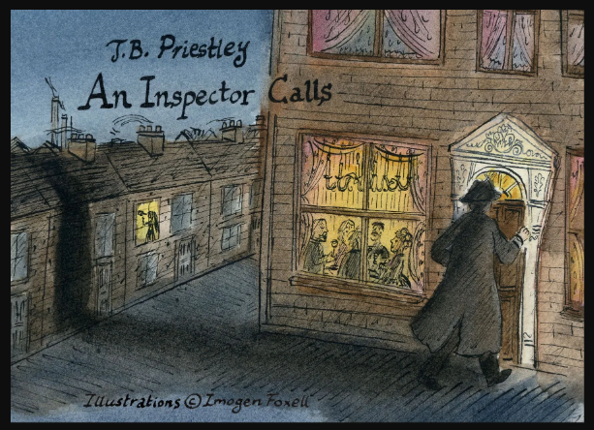
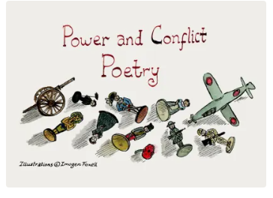
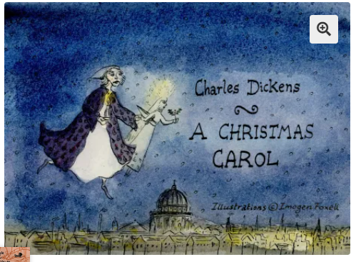
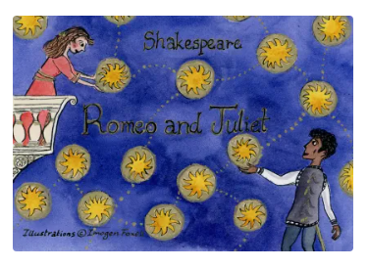
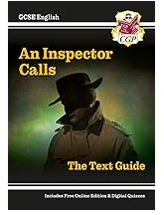
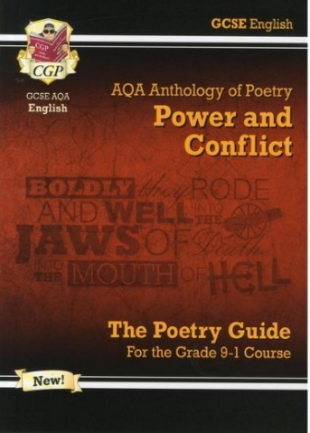
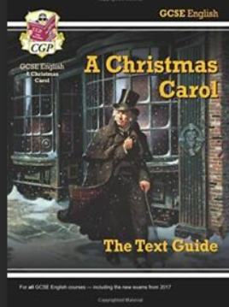
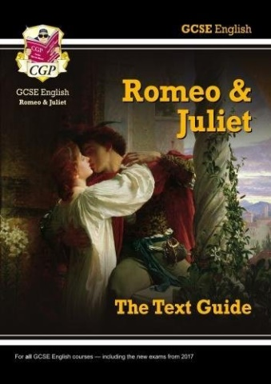
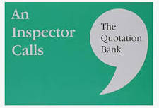
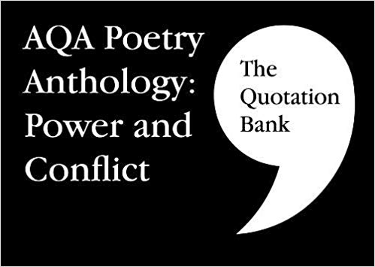
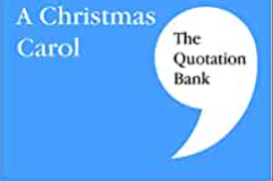
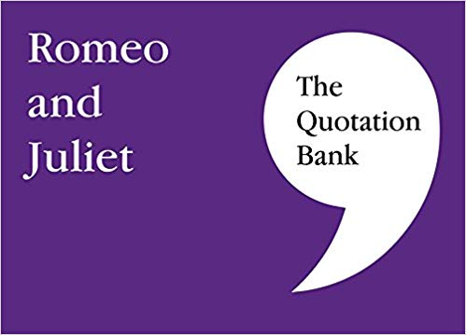
Revision Guides
www.flipscocards.com (£2.99)

Slide 25
Homework
Weekly Homework: Language & Literature
Two homework tasks each week: one for Language and one for Literature.
The PowerPoints on Satchel explain exactly what to do for each task.
Language (Paper 2, Question 5). They will follow a two-week cycle:
Week B: Plan a response to Paper 2, Question 5.
Week A: Write the full response.
Literature (Poetry)Create four flashcards for the specified poems.
Remember: one of these will be the named poem in the exam, so they should learn their flashcards thoroughly.

