Slide 1

Year 11 MFL Revision ideas
The key to successful revision in MFL is little but often.

Slide 2
REVISION BOOKS AND CARDS

Slide 3
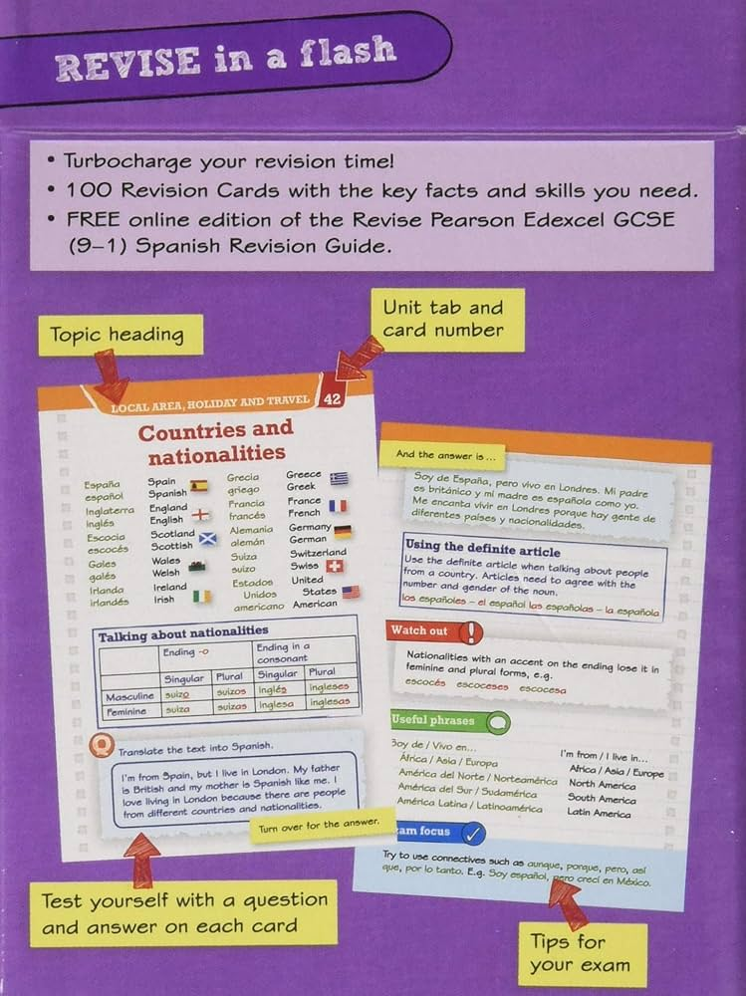

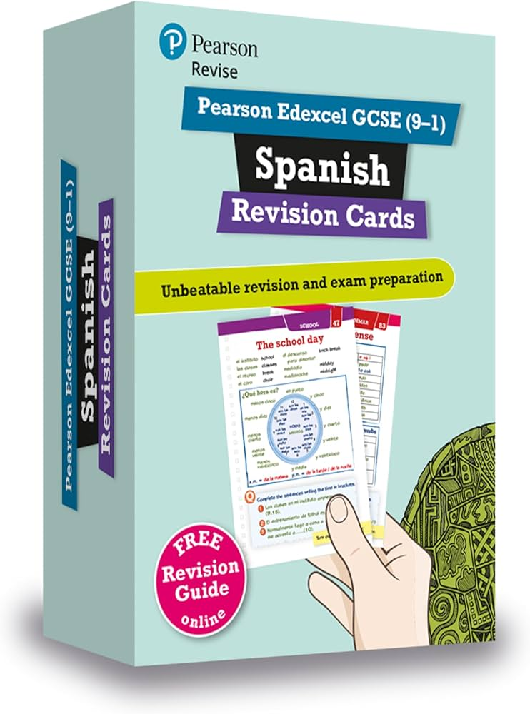


Slide 4
APPS AND WEBSITES

Slide 5


Slide 6


Slide 7


Slide 8


Slide 9
MINDMAPS

Slide 10
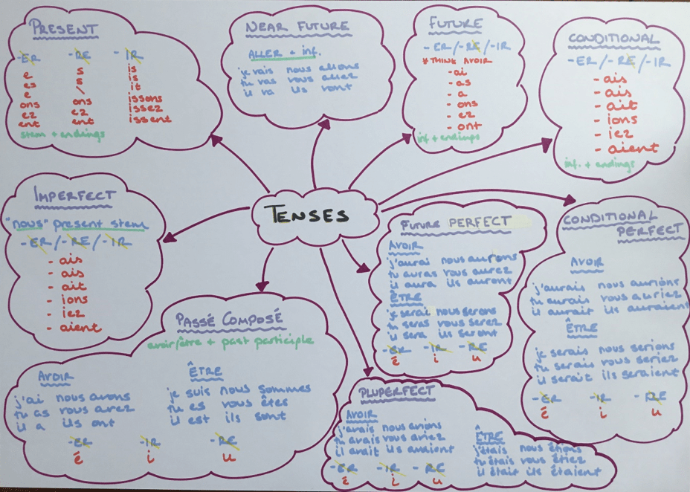

Slide 11
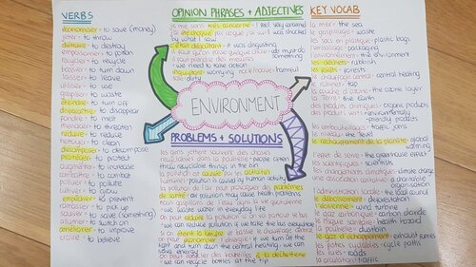

Slide 12
REVISION WHEELS

Slide 13
Describing myself
Ideal partner
Physical traits
personality
Je suis
Je ne suis pas
J’ai
Je suis
Other people
Relationships
Positives
Key verbs
Negatives
Family/friends
UNIT 1
Describing relationships
Describing others
serait
Positives
Negatives
aurait
Relationship reasons
Ideal partner
Positives
Key verbs
Future plans
Marriage
Negatives
Marriage
alternatives
Opinions on marriage and future plans

Slide 14
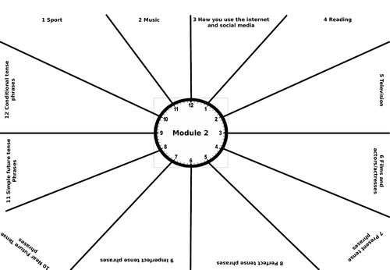

Slide 15
FLASHCARDS

Slide 16
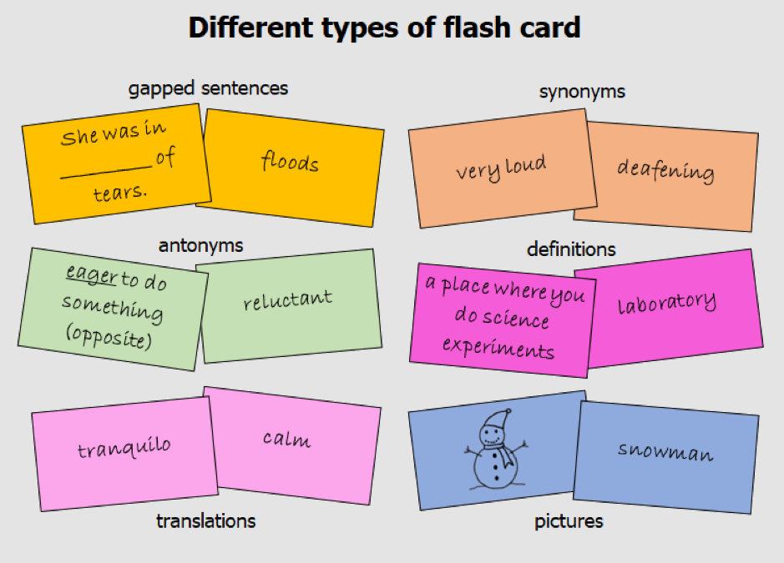

Slide 17
TARSIA PUZZLES

Slide 18
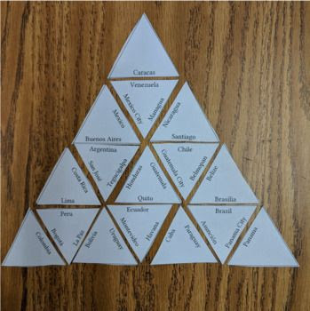

Slide 19
RAG Vocabulary

Slide 20
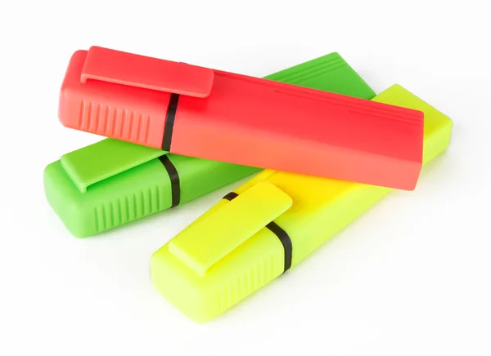

Slide 21
REVISION PLANS

Slide 22
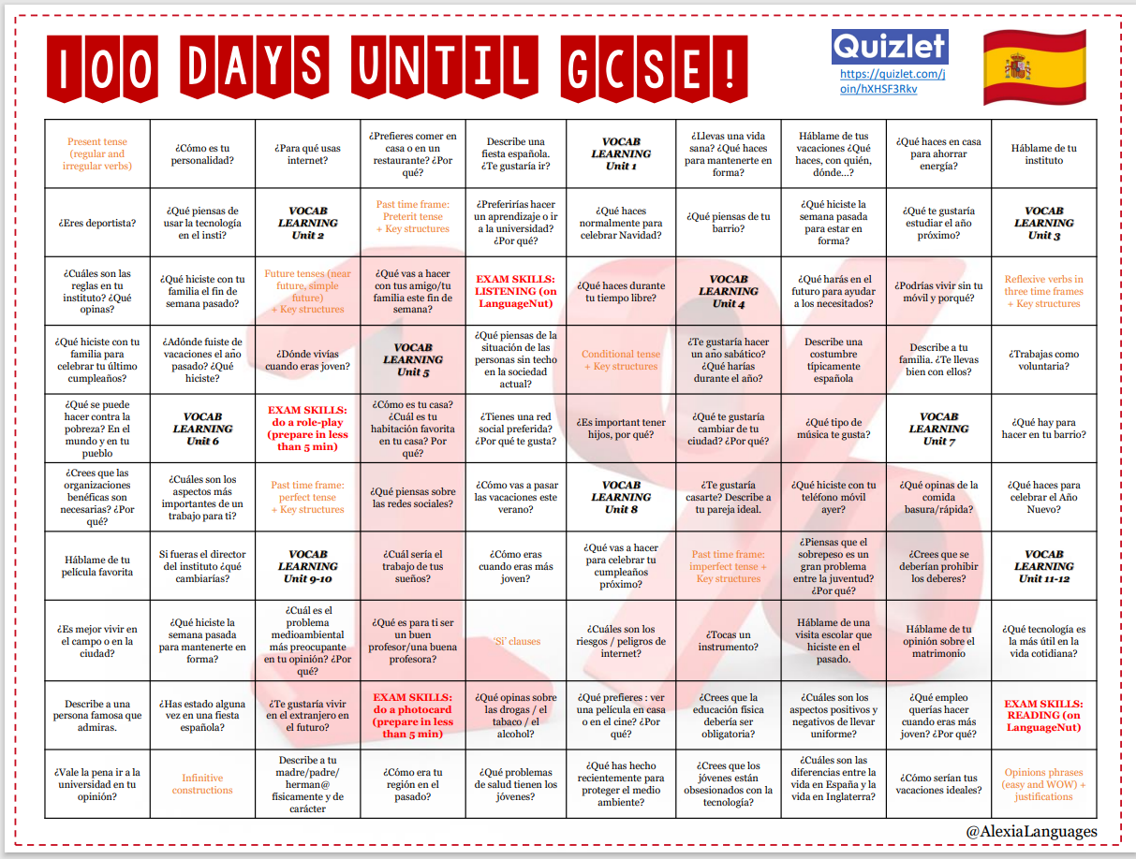

Slide 23
