Slide 1
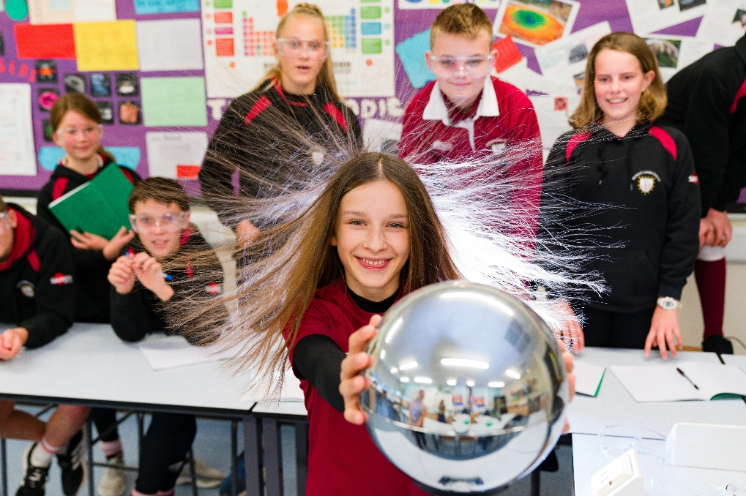
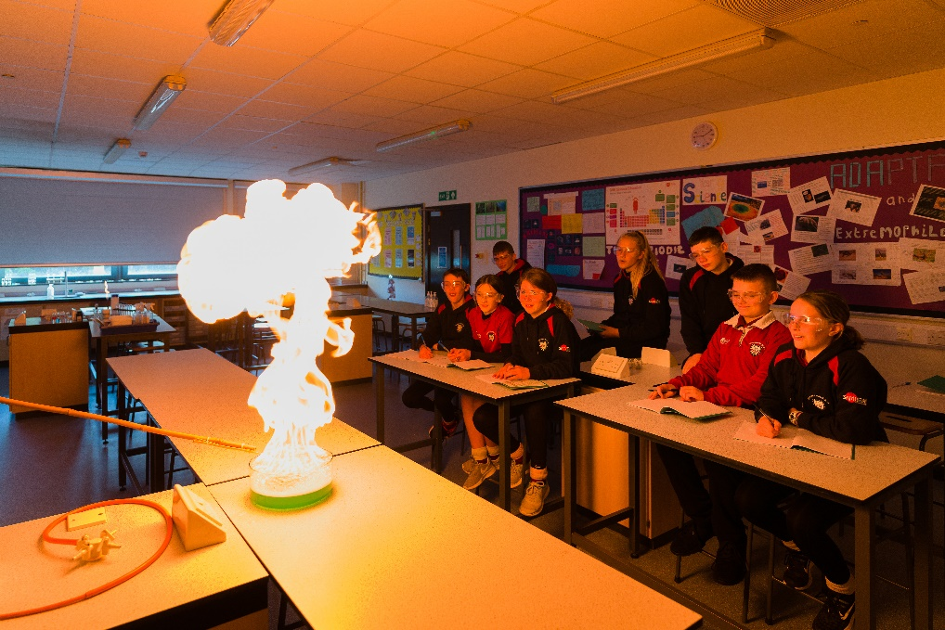

Welcome
GCSE Triple Science Revision
Notes:
Well done
A good start
Yr 11 Programme
Yr 10 responsibility – senior students

Slide 2

Exam Board: AQA
GCSE Biology 8461
GCSE Chemistry 8462
GCSE Physics 8463

Slide 3
12th May 2026
18th May 2026
2nd June 2026
Biology
Paper 1
100 marks
1 hour 45 min
Chemistry
Paper 1
100 marks
1 hour 45 min
Physics
Paper 1
100 marks
1 hour 45 min
8th June 2026
12th June 2026
15th June 2026
Biology
Paper 2
100 marks
1 hour 45 min
Chemistry
Paper 2
100 marks
1 hour 45 min
Physics
Paper 2
100 marks
1 hour 45 min
One GCSE Grade
9-1
One GCSE Grade
9-1
One GCSE Grade
9-1
Notes:
Paper 1 content was taught in year 10, Paper 2 content is being taught in year 11. Some topics from both papers were taught during year 9.
Exam dates have been taken from the AQA calendar https://cdn.sanity.io/files/p28bar15/green/c5e9f9bae7272b1b48a42130fc04d77f6dd0d5b5.pdf

Slide 4
AQA GCSE: Triple Biology
Biology Paper 1
B1 = Cell structure and transport
B2 = Cell division
B3 = Organisation and the digestive system
B4 =Organising animals and plants
B5 = Communicable diseases
B6 = Preventing and treating disease
B7 = Non-communicable diseases
B8 = Photosynthesis
B9 = Respiration
Biology Paper 2
B10 = The human nervous system
B11 = Hormonal co-ordination
B12 Homeostasis in action
B13 = Reproduction
B14 = Variation and evolution
B15 = Genetics and evolution
B16 = Adaptations, interdependence and competition
B17 = Organising an ecosystem
B18 = Biodiversity and ecosystems

Slide 5
AQA GCSE: Triple Chemistry
Chemistry Paper 1
C1 = Atomic structure
C2 = The periodic table
C3 = Structure and bonding
C4 = Chemical calculations
C5 = Chemical changes
C6 = Electrolysis
C7 = Energy Changes
Chemistry Paper 2
C8 = Rates and equilibrium
C9 = Crude oil and fuels
C10 = Organic reactions
C11 Polymers
C12 = Chemical analysis
C13 = The Earth’s atmosphere
C14 = The Earth’s resources
C15 = Using our resources

Slide 6
AQA GCSE: Triple Physics
Physics Paper 1
P1 = Conservation and dissipation of energy
P2 = Energy transfer by heating
P3 = Energy resources
P4 = Electric circuits
P5 = Electricity in the home
P6 = Molecules and matter
P7 = Radioactivity
Physics Paper 2
P8 = Forces in balance P9 = Motion
P10 = Forces and motion
P11 = Force and pressure
P12 = Wave properties
P13 = Electromagnetic waves
P14 = Light
P15 = Electromagnetism
P16 = Space

Slide 7
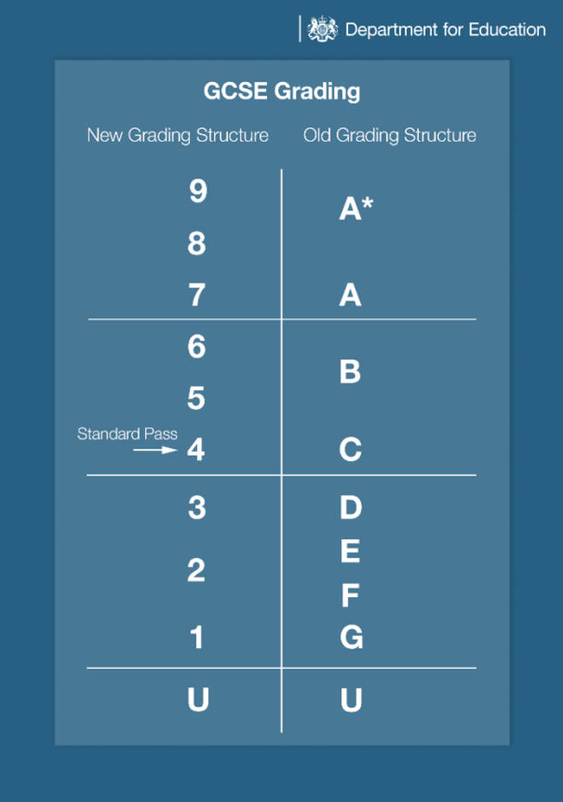
GCSE Triple Science Grading
Students will be awarded 3 separate science GCSEs – Biology, Chemistry and Physics.
The marks from both exam papers (e.g. biology) are added up to give a mark out of 200.
This score out of 200 generates the final grade.

Slide 8
GCSE Triple Science Grading
Tiers of Entry
Higher Tier - Students can be awarded grades from 9 to 3
Foundation tier- Students can be awarded grades from 5 to 1
Notes:
For Higher Tier, grade 3 is a “safety net” grade awarded to students who narrowly miss a grade 4. Failing to meet this mark would result in a grade U.

Slide 9
Year 11 Mock Exams
w/c Monday 3rd November Paper 1 Biology, Paper 1 Chemistry, Paper 1 Physics
w/c Monday 23rd February Paper 2 Biology, Paper 2 Chemistry, Paper 2 Physics

Slide 10
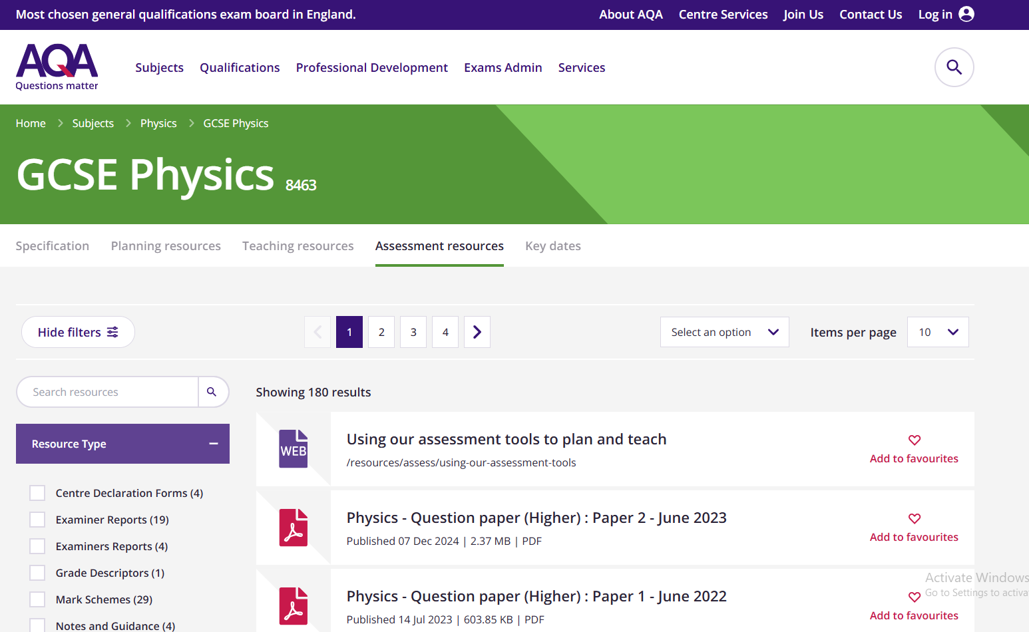
Past papers and mark schemes are available from www.aqa.org
Notes:
The AQA website has past papers and mark schemes available to download.

Slide 11
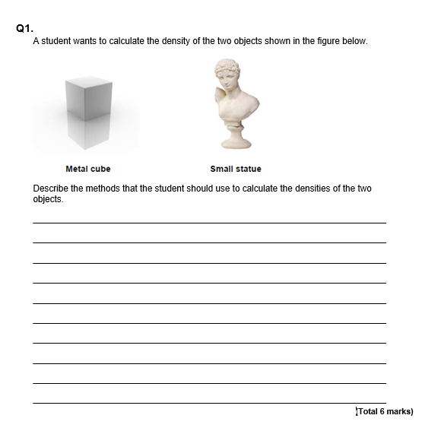
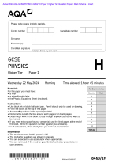
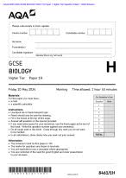
Question Style
Mixture of multiple choice, structured, closed short answer, and open response.
There are 28 Required Practicals across the 3 disciplines. Students will be examined on a selection of these practicals.
Notes:
This is an example of an open response question, the longest question type in the exams (6 marks max)

Slide 12
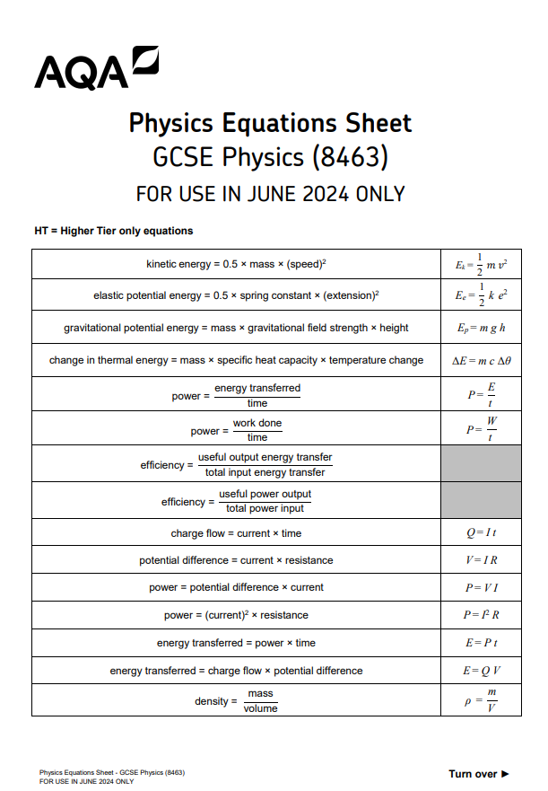
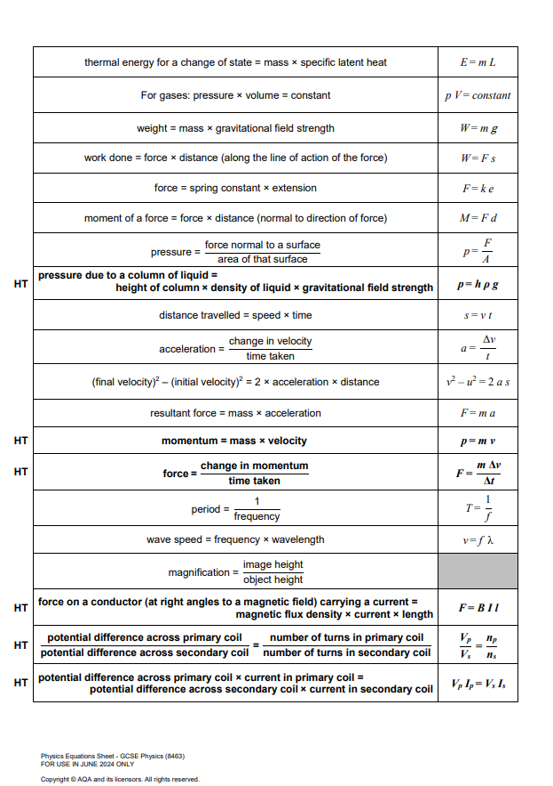
Notes:
This is a copy of the equation sheet which is given to all students for use in the exams. For both of the chemistry exams students are also given a periodic table. Calculators are permitted for use in all Science GCSE exams.

Slide 13
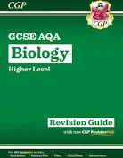
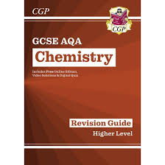
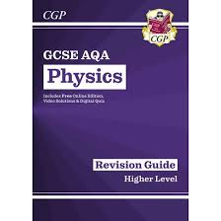
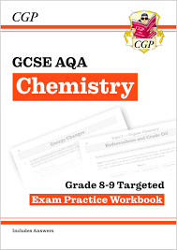
Revision guides available on ParentPay for £10.75 (set of 3)
Grade 8-9 Workbooks are also available on ParentPay for £10.75 (set of 3)

Slide 14

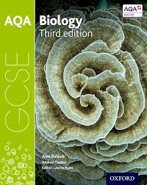
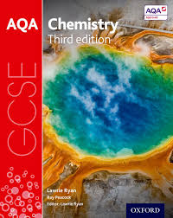
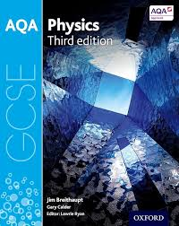
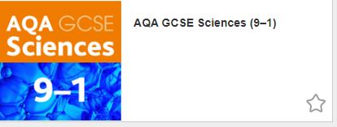
www.kerboodle.com
Online textbooks are available to view on the Kerboodle website

Slide 15


Slide 16
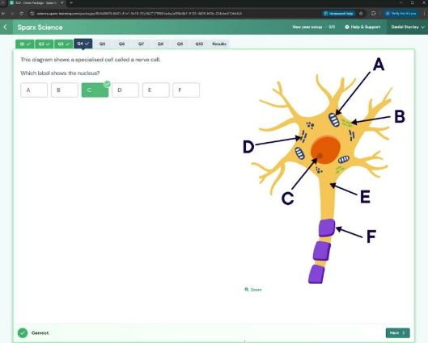
What is Sparx Science?
Sparx Science provides personalised homework that aids retention and recall.
Teachers will set topics that are coming up in the first mock series, in November.
Sometimes science questions may challenge students, however where this is the case Sparx provides unique support to fill knowledge gaps or guide them through application of scientific ideas.

Slide 17
How can you help?
Provide a quiet space for your child to focus on their homework, minimising distractions where possible.
Encourage your child to start their homework early so they can get support before the deadline if they are stuck.
Sparx Science will automatically adjust the level of questions based on your child’s answers, please try not to answer the questions for them, instead ensure they are carefully reading the support and using this information to answer the questions.

Slide 18
Key details
Students log in at app.sparx-learning.com. They will need to find their school and log in using their Sparx Maths details.
Homework will be handed out on Tuesday every week, and collected on Monday
Each Sparx Science homework should take 1 hour.

Slide 19
After School Science Revision Classes
Every Monday 3pm-4pm starting this Monday 22nd September.
Notes:
Details of rooms/topics will be posted on Moodle

