Slide 1



Year 11 Parent Information Evening: Revision
Notes:
Welcome. Thank you for coming.
Tonight is about giving you the opportunity to see how you can support your child’s revision.

Slide 2

5 key areas:
Organisation
Attendance
Concentration
Repetition
Mental health
Notes:
I am briefly going to go over 5 key area you should be discussing with your child,
then you will have the opportunity to attend subject specific sessions.

Slide 3
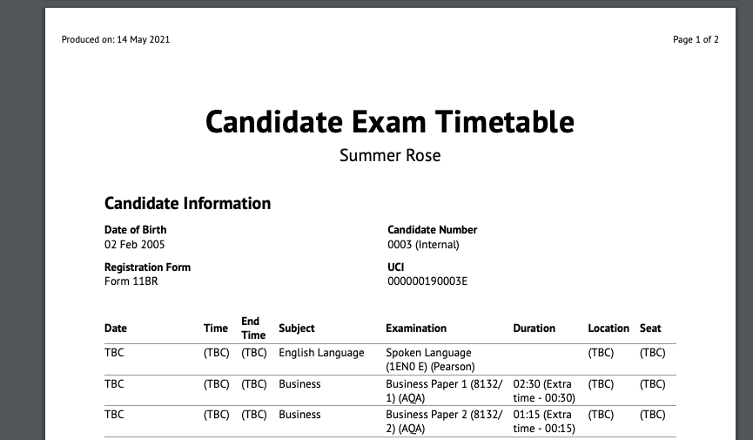
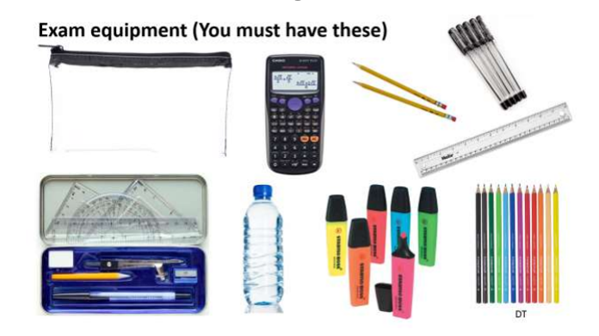
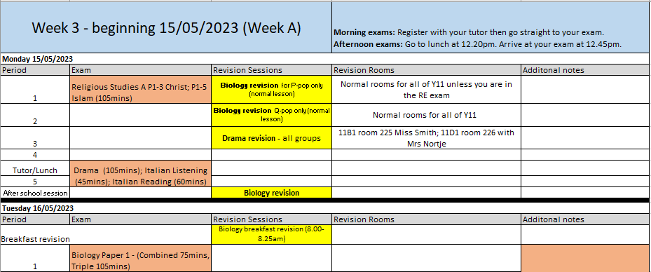
1) Organisation
Exam order
RLS revision sessions
Equipment
Notes:
1) Organisation
Do they have the equipment they need?
Match the order of the topics they are revising to the order of their exams.

Slide 4
2) Attendance
A progress score of 1.0 means your child achieved an average of one grade higher in every qualification compared to similar students nationally.
1.0
0.5
0
-0.5
-1.0
-1.5
-2.0
80-84%
75-79%
Below 75%
Progress
95-100%
90-94%
85-89%
Attendance
Notes:
2) Attendance is linked to progress.
On average, students with good attendance achieve one grade higher in every subject, compare to students with low attendance.
In lessons your child will have the support of the teacher to revise difficult concepts and review specific areas they have previously struggled with.
There is no substitute for in-lesson revision.

Slide 5
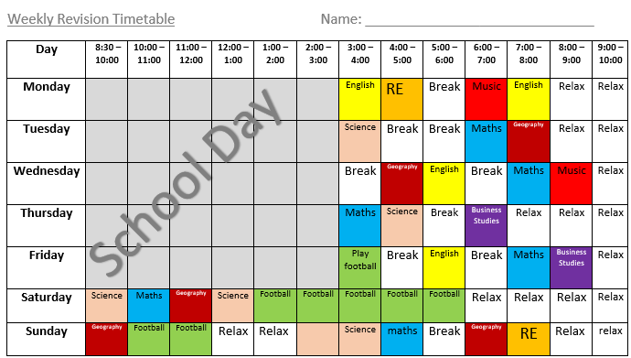

3) Concentration
Notes:
3) Concentration
Students need to ditch their phone. Revision required deep thought and intense concentration. If a friend gets bored and messages your child, they are sabotaging their revision.
Set limits on social life – it now needs to go on the back burner. They should still see friends but this should fit around their revision schedule.

Slide 6
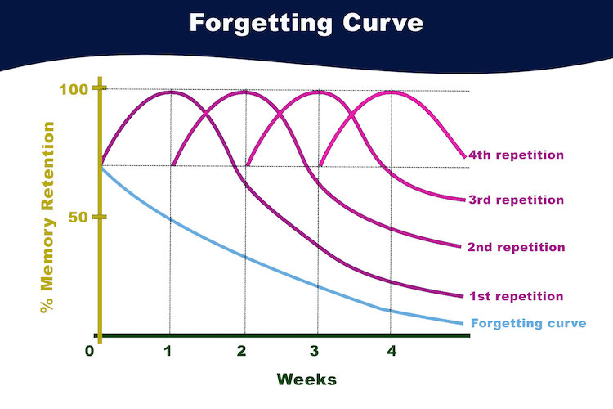
4) Repetition
Notes:
4) Repetition
Spaced repetition is a learning technique which is often practised with flashcards.
This technique has been scientifically proven to increase the rate of learning and can be extremely beneficial to those who learn quicker from repeated exposure to information.

Slide 7
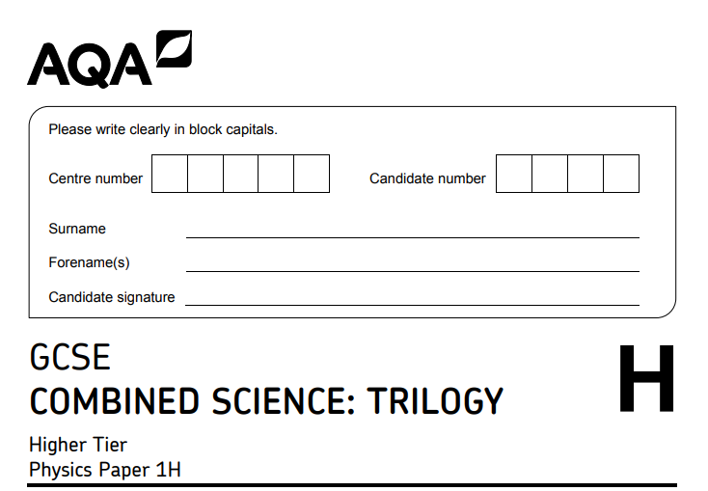
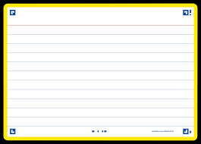
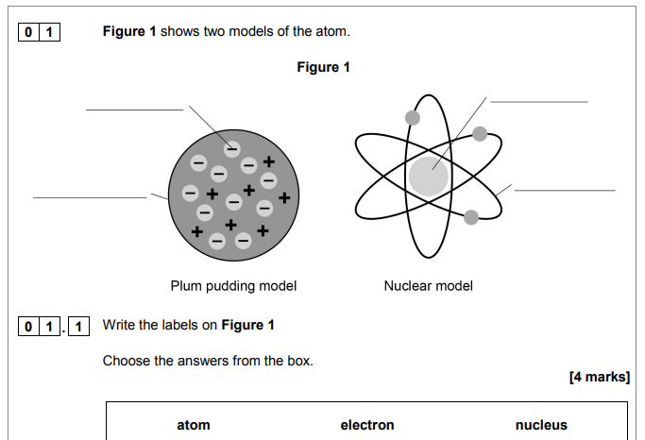
Past papers
What is osmosis?
Osmosis is the diffusion of water molecules, from a region where the water molecules are in higher concentration, to a region where they are in lower concentration, through a partially permeable membrane.
Flashcards
Notes:
Flash cards and past papers are two ways to use repetition in revision.

Slide 8

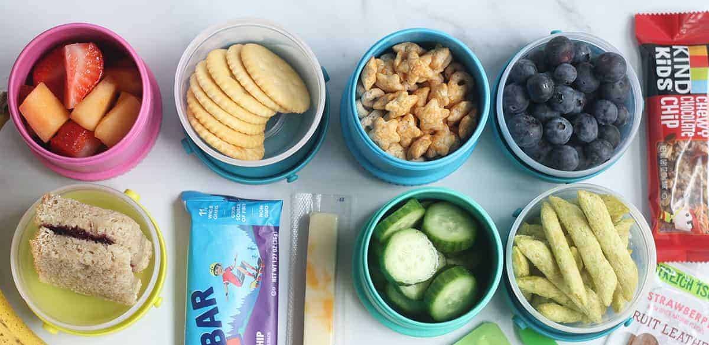


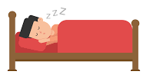
5) Mental Health
Help your child get enough sleep
Encourage exercise during exams
Make sure your child eats well
Be flexible during exams
Talk about exam nerves
Notes:
Constantly revising without a break can make you feel drained, so it's crucial that you take time to step back and do something that you enjoy.
8-10 hours’ sleep.
Exercise can help boost energy levels, clear the mind and relieve stress.
Eat well
Talk about exam nerves – this is normal – put the nerves to good use.
If your child is struggling – speak to their tutor or Mrs Doherty.

Slide 9
Option Subjects
French & Spanish – Room 125
History – Room 124
Geography – Room 123
DT (Engineering/ Graphics/ DT) – Room 114
If you do not have an option subject available please return to the main hall for a general session.
Session | Rame | Towan | Pentire | Godrevy
1 6.15-6.30pm | Maths Room 129 | Science Room 107Combined Room 106 Triple | English Room 103 & 104 | Option Subjects
2 6.30-6.45pm | Option Subjects | Maths Room 129 | Science Room 107 Combined Room 106 Triple | English Room 103 & 104
3 6.45-7.00pm | English Room 103 & 104 | Option Subjects | Maths Room 129 | Science Room 107 Combined Room 106 Triple
4 7.00-7.15pm | Science Room 107 Combined Room 106 Triple | English Room 103 & 104 | Option Subjects | Maths Room 129
5 7.15-7.30pm | Option Subjects | Option Subjects | Option Subjects | Option Subjects
Notes:
Move to sessions.
No option session to go to, stay in the Hall

Slide 10
General Session
Homework/Coursework
Creating the right environment
Preparing for tests

Slide 11
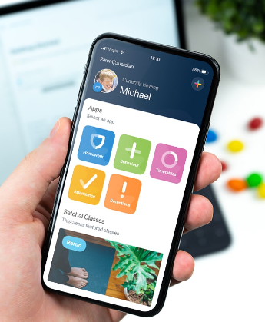
Homework/Coursework
All homework is recorded on Satchel One.
Students and Parents/Carers all have access to Satchel One.
Please log-in regularly and check that your child is managing their homework.
Speak to your child about their coursework. Contact their teacher if you are concerned about their progress.
Catch-up sessions are offered by coursework subjects.

Slide 12
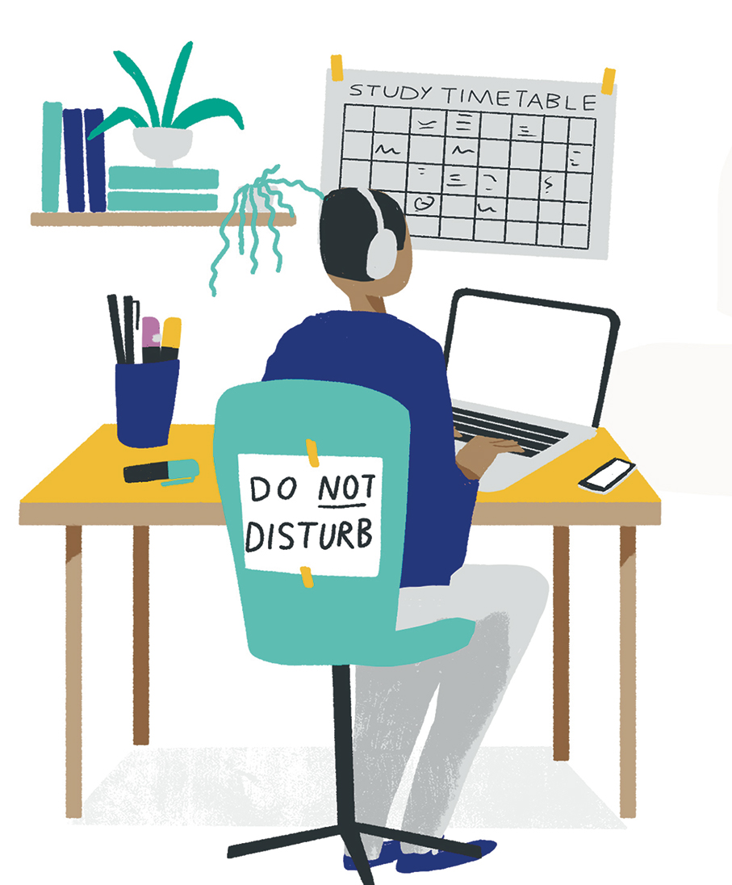
Creating the right environment
Creating a study space is a really positive thing to do – away from all distractions if possible.
Make sure your child has everything they need – notebooks, revision books, pens, paper, post-it notes, index cards, and so on.
You could buy folders that allow them to divide and organise their work into sections, so their work is easy to access.

Slide 13
Preparing for tests
When it comes to sitting down and doing some revision, though, here are a few top tips you might like to share:
Help your child create an overview of what they need to revise and break each subject down into manageable chunks. This is where knowledge of the exam board specification will help.
Set definite start and finish times for revision sessions and have a clear goal for each session.
Get your child to ask your teachers for practice questions or past papers.

Slide 14
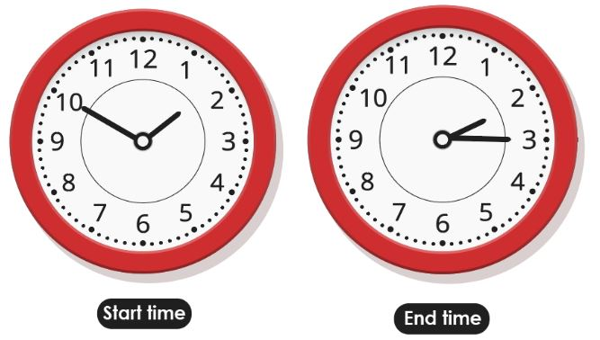

Preparing for tests
Get them to practise making plans and answering questions under timed conditions.
During breaks, have your child do something completely different – for example, they could listen to music, have a chocolate biscuit, or make a cup of tea.
Ensure they make their revision active. Don’t allow them to just read notes – make flash cards or mind maps, or use the post-it notes you bought when setting up a study space. Then make sure they ‘apply’ what they’ve learned – in other words, get them to do something with their knowledge (such as a practice exam question).

